Slide 1



SESSION NAME HERE
Programming Basics

Slide 2


Foundational Sessions Housekeeping
The use of disrespectful language is prohibited in the questions, this is a supportive, learning environment for all - please engage accordingly. (FBV: Mutual Respect.)
No question is daft or silly - ask them!
There are Q&A sessions midway and at the end of the session, should you wish to ask any follow-up questions. Moderators are going to be answering questions as the session progresses as well.
If you have any questions outside of this lecture, or that are not answered during this lecture, please do submit these for upcoming Open Classes. You can submit these questions here:
SE Open Class Questions or DS Open Class Questions

Slide 3
Foundational Sessions Housekeeping cont.
For all non-academic questions, please submit a query: www.hyperiondev.com/support
Report a safeguarding incident: www.hyperiondev.com/safeguardreporting
We would love your feedback on lectures: Feedback on Lectures

Slide 4


Reminders!
Guided Learning Hours
By now, ideally you should have 7 GLHs per week accrued. Remember to attend any and all sessions for support, and to ensure you reach 112 GLHs by the close of your Skills Bootcamp.
CONFIDENTIAL

Slide 5
Progression Criteria
✅ Criterion 1: Initial Requirements
Complete 15 hours of Guided Learning Hours and the first four tasks within two weeks.
✅ Criterion 2: Mid-Course Progress
Software Engineering: Finish 14 tasks by week 8.
Data Science: Finish 13 tasks by week 8.
✅ Criterion 3: Post-Course Progress
Complete all mandatory tasks by 24th March 2024.
Record an Invitation to Interview within 4 weeks of course completion, or by 30th March 2024.
Achieve 112 GLH by 24th March 2024.
✅ Criterion 4: Employability
Record a Final Job Outcome within 12 weeks of graduation, or by 23rd September 2024.
CONFIDENTIAL

Slide 6

Programming
Basics
Variables, Data Types, Containers
Functions
Classes

Slide 7

Assumptions
Python 3.8 and above installed
VS Code, PyCharm, Colab, anything that that can run Python

Slide 8
Definition | Variables are names memory locations used to store data.
 |  |  | Code | Examples | Properties
Types | Single memory location | Number | int, float | age = 12 (int) height = 12.0 (float)
 |  | Strings | str | name = "Jaycee" | - Immutable - Treat as an immutable list of characters
 |  | Boolean | bool | open=True | - Only True or False
 | Many memory locations (Containers) | List | list or [] | groceries = ["apple", "banana", "cherry] | - Mutable - Dynamic Size - Can accommodate any other data types, including lists
 |  | Dictionaries | dict or {} | country_capitals = { "South Africa": "Pretoria", "Canada": "Ottawa", "England": "London" } | - key, value structure
 |  | Tuples | tuple or () | x_coordinates = (0.0, 1.5) | - Immutable - Can't be sorted
 |  | Set | set or {} | {0,1,2,3,6,4,6} | - No duplicates

Slide 9
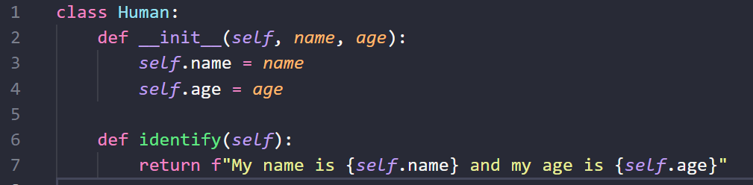
Functions And Classes
A class is a blueprint that defines a nature of a future object.
A method a programmed procedure that is defined as part of a class and is available to any object instantiated from that class

Slide 10


Thank you
for joining us
Take regular breaks
Stay hydrated
Avoid prolonged screen time
Practice good posture
Get regular exercise
“With great power comes great responsibility”

Slide 11


Questions and Answers
Questions around Programming Basics

